Slide 1

Auction Framework
Gantushig Javkhlan 610162
Henok Gebremenfes 987505
Battushig Namsraidorj 610114

Slide 2
Contents
Overview
Design decisions
Implementation Advice

Slide 3
Overview
What is an auction?
An auction is a process of buying and selling goods or services by offering them up for bid, taking bids, and then selling the item to the highest bidder.[1]
Why we chose it?
Auction has its own established rules depending on item type, category etc. We’ve tried to integrate this business knowledge into our framework so that application developers can build their products more quickly. Additionally, we all have a basic understanding of how auction works, thus allowed us focus on how to implement various design patterns in our project, instead of solving complex algorithms.
https://en.wikipedia.org/wiki/Auction

Slide 4
Design Decisions
Our framework will allow User (App Developer) to use following things:
Built-in auction types - There are couple of specific auction types that are commonly used in the industry. We have implemented them already in the framework so application developer doesn’t have to write code from scratch. If developers want to create a new types of auction or add features specific to to their requirements, our framework will allow them to override default strategies.
Built-in auction type
Absolute
Minimal

Slide 5
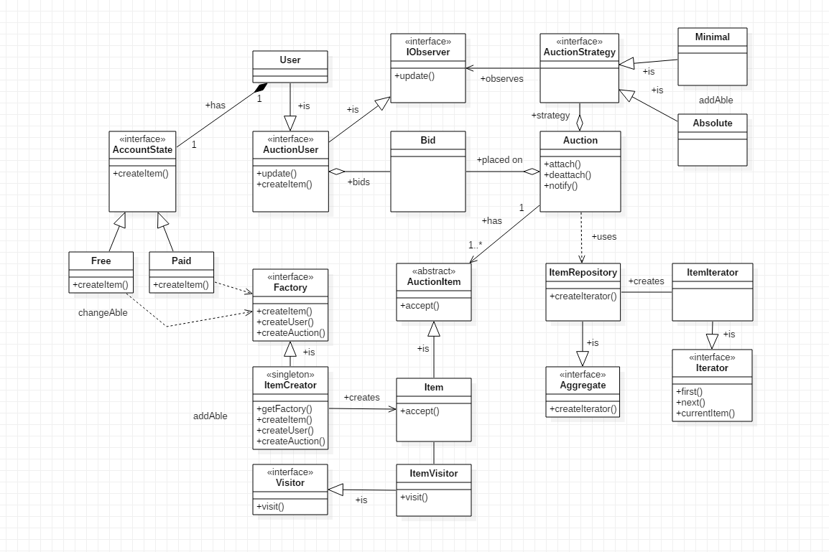
Class diagram

Slide 6
Design Decisions:Use of Patterns
Auction type pricing :- Built-in- different operation of the strategy types or create new types.
Absolute (Strategy pattern ): An absolute auction is the most common type of auction in which items or properties are auctioned off to the highest bidder. In this type of auction, the item or property is guaranteed to be sold because there is no minimum price that the seller is looking to hit. This creates a lot of interest and competition among bidders.
Minimum (Strategy pattern): In a minimum bid auction, the bidding begins at a minimum price that the seller is willing to accept. This price is published ahead of time in brochures and advertisements, and is announced at the auction. Holding a minimum bid auction is a good way for the seller to ensure they will be compensated with an amount they consider to be acceptable. But the price must be chosen wisely in order to ensure that as many bidders as possible will still be interested in attending the auction and not feel priced out.

Slide 7
Membership type(State pattern)
Paid and Free Membership (State pattern): If developers want to categorize users, they need to implement AccountState interface. For example, paid or free members.
Calculation methods (Visitor pattern): Different calculation methods depending on item type.
Bid status update (Observer pattern): The participants of the auction must get notified for current auction status simultaneously.

Slide 8
Design Decisions: Use of Patterns
Item and User (Factory method, Singleton pattern): We used factory method for creating a new User and Auction Item.
Item Iterator (Iterator pattern): In order to access elements in any collection we build a ItemIterator class.

Slide 9
Implementation Advice
Default usage: The following interfaces are must be implemented:
AuctionUser - for participants of auction
AuctionItem - for Auction items
App developer must create an Auction instance of selected auction type and ready to use.
If developers need more features they can override.

